Slide 1
1
UNIX Operating System

Slide 2
12
Module 1
Introduction to Unix

Slide 3
Objectives
4
Upon completing this module you should be able to understand the following:
◻
What is an Operating System History of unix Operating system Unix Architecture
More features of unix Unix Flavors
Linux Flavors
◻
◻
◻
◻
◻

Slide 4
What Is an Operating System?
5
•
•
•
Interface between Users and the Hardware Take care of Storage Management
Take care of I/O device management
Notes:
An operating system (OS) is system software that manages computer hardware, software resources, and provides common services for computer programs.
UNIX is an operating system which was first developed in the 1960s.

Slide 5
UNIX Variants
Year | UNIX Variant | Features
1957 | BESYS | At Bell Labs To run batch jobs
1965 | MULTICS (Multiplexed Information and Computing Service) | Adopted third generation computer equipments
1969 | UNICS (UNiplexed Information and Computing Service) | To play space travel on another smaller machine (DEC PDP-7)
1971 | UNIX | The first edition of the "UNIX PROGRAMMER'S MANUAL” By K. Thompson [and] D. M. Ritchie; included over 60 commands
5
UNIX Variants
Notes:
Key Message/s:
In 1957 BESYS operating system was created at Bell Labs to run various batch jobs.
In 1965 Bell decided to create MULTICS (Multiplexed Information and Computing Services) using third generation computer equipments
In 1969 MULTICS was withdrawn by Bell. To play space travel on DEC PDP-7 (Programmed Data Processor) Ken Thompson and Dennis Ritchie rewrote an operating system called UNICS (UNiplexed Information and Computing Service)
First edition of UNIX released on 11/03/1971. It included over 60 commands.
Additional Information:

Slide 6
UNIX Variants
UNIX Variant | Features
AIX (Advanced Interactive eXecutive) | Developed By IBM in 1990 Shells available (Korn, Bourne, C) Default Korn shell
BSD (Berkeley Software Distribution) | Developed at the Computer System Research Group (CSRG)
Sun Solaris | Sun company's UNIX variant operating system
MINIX | A free UNIX clone written from scratch Small size Micro kernel-based design and simple documentation Suited for personal computer
6
UNIX Popular Variants
Notes:
Key Message/s:
In February 1990 Advanced Interactive eXecutive (AIX)of IBM came into market. It offers Korn (ksh), Bourne (sh) and c (csh) shells. But by default it uses ksh .
BSD was an OS. It was developed at Computer System Research Group at University of California at Berkeley.
Sun Solaris is known as sun or SunOS and is UNIX variant of Sun Company.
HP-UX was based on System V and was introduced in 1986. It is operating environment server as the foundation for critical applications and IT services over Internet.
MINIX is written from scratch and clone of UNIX. It is small in size and suitable to run on personal computer.
Additional Information:

Slide 7
LINUX
Developed by Linus Torvalds
Freely available multitasking and multi-user operating system
Placed under General Public License
Variants
Caldera Linux
Debian Linux
Kondara Linux
Red Hat Linux
Ubuntu Linux
Notes:
Key Message/s:
LINUX is developed by Linus Torvalds and further elaborated by a number of developers throughout the world. Linux is a freely available multitasking and multi-user operating system.
Linux is placed under General Public License.
Additional Information:

Slide 8
UNIX Flavors
Originator | Proprietary Name
U. Cal. Berkley | BSD
Sun | Solaris
IBM | AIX
HP | HP - UX
SGI | IRIX
Digital Equipment² | DEC UNIX
Compaq | Tru64 UNIX³
Apple | MacOS X⁴
L. Torvalds/GNU⁵ | Linux⁶
8
All proprietary UNIX flavors and their names are respective trademarks of the originating entity/vendor.
Notes:
Key Message/s:
Additional Information:

Slide 9
What is Unix OS
Unix is an operation system developed in the Bell Laboratories of AT and T.
Unix is multi-tasking, multi-user, high secure Operating system.
It provides its users with: program development tools
Electronic communications facilities, such as electronic mail, text editor and text formatters.

Slide 10
UNIX Architecture – Kernel & Shell
7
User
Shell
Kernel
Hardware

Slide 11
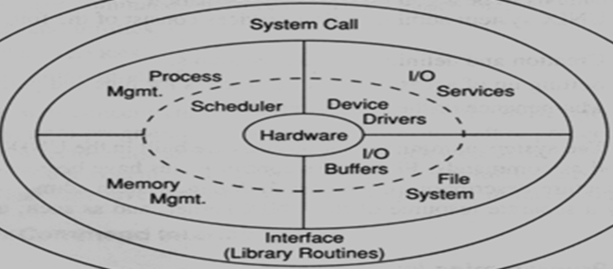
UNIX Onion Architecture (1 of 2)
User Process
Shell
Shell
Shell
Shell
User Process
It provides file system, CPU scheduling, memory management, and other OS functions using system calls.
Everything below the system call interface and above the physical hardware is the KERNEL.
11
11
Notes:
Key Message/s:
System Call:
It is used to invoke an operating system routine. The routine is stored in the kernel.
Roughly there are three system calls in UNIX.
File manipulation (same system call also supports device manipulation)
Process control
Information manipulation
Uses: (This is not exhaustive)
Through system calls many low level jobs like read, write, open, exec, kill etc can be executed efficiently.
System calls provide the interface between a process and the kernel.
The OS routines have highest level of privilege. When a system call is triggered, the system enters a higher privilege level, and the routine is executed.
System calls provide an opportunity to execute a specific set of instructions which the interrupting program has no direct control over.
Amongst the functions performed by the kernel are:
Managing the machine's memory and allocating it to each process
Scheduling the work done by the CPU so that the work of each user is carried out as efficiently as is possible
Organizing the transfer of data from one part of the machine to another
Accepting instructions from the shell and carrying them out
Enforcing the access permissions that are in force on the file system

Slide 12
UNIX Onion Architecture (2 of 2)
User Process
Shell
Shell
Shell
The system call interface layer converts a process running in user mode to a protected kernel mode process.
Shell
User Process
System call provides a programming interface that allows user programs to access kernel functions.
12
Notes:
Key Message/s:
Additional Information:

Slide 13
User Application and Kernel Interaction
Utilities are set of UNIX commands and Programs.
User
Users enter UNIX commands or run different software applications.
Applications
Applications are different softwares run on UNIX.
Utility
Shell
Shell is a command interpreter of UNIX.
Kernel
Kernel controls the underlying hardware. The kernel provides low-level device, memory, and processor management functions.
The Operating System
Hardware
Notes:
Key Message/s:
Additional Information:

Slide 14
System call
The interface between a process and an operating system is provided by system call.
Or
System call is the programmatic way in which a computer program requests a service from the kernel of the operating system it is executed on it.
System calls are available as assembly language instructions.
System call usually made when a process in user mode requires access to resource.
System call provides the services of the operating system to the user programs via Application Programming interface(API)

Slide 15
Kernel
The kernel is a computer program at the core of a computer’s operating system with complete control over everything in the system.
It is an integral part of any operating system
It is the “portion of the operating system code that is always resident in the memory”.

Slide 16
Continue…
Permitting process controlled access
Devices like terminals
Disk and tape drives
Network drives
Controlling the process execution
Creation
Termination
Suspension
Communication
Efficient retrieval and storage of user data
By allocating storage
By reclaiming unused storage
Protecting

Slide 17
Continue…
Time sharing
Suspending the process
Rescheduling the processes
Sharing of main memory
Swapping system
17
Notes:
Key Message/s:
Additional Information:
Refer the sheet prepared for UNIX Features.
Same needs to be referred for the services.
File Structure is the feature which ensures the efficient retrieval and storage in well understood manner of user data by allocating and de-allocating unused storage to the files and also illegal access of files.
Time sharing – suspension and rescheduling the process based on quantum.
Swapping system – it allows sharing of main memory

Slide 18
More Features of UNIX
9
Hierarchical file system
Multi tasking
Multi user
The building block approach
Pattern matching (wildcard characters)
Toolkit(Applications, RDBMSs, Languages etc..)
Programming facility
Documentation

Slide 19
12
Module 2
Logging In and Basic Commands

Slide 20
Objectives
13
Upon completing this module you should be able to understand the following:
◻
◻
◻
◻
◻
◻
◻
◻
◻
◻
Logging In and Out Command Line Format The Secondary Prompt Online Manual Pages id Command
who Command date Command
cal, clear Commands passwd Command finger command

Slide 21
Processing Environment
21
A program is a set of instructions written to perform a specific task.
A process is:
An operation which takes the instructions given and does the manipulations or anything that is instructed in the code itself
The single executable module that runs concurrently with other executable modules
A program in execution
Notes:
Key Message/s:
Additional Information:

Slide 22
Shell as Command Interpreter
Each line that shell reads from standard input is called a pipeline.
Shell as a command interpreter:
Reads lines from standard input (each of these line is called pipeline)
Splits the command into tokens
Checks the token to see if it’s a keyword
Checks the first word for alias
Performs command substitution for any $(string)
Performs wildcard expansion
Looks at first word as build-in command
Runs the command
22
Notes:
Key Message/s:
Other things that the Shell does as Command Interpreter are:
Substitutes $HOME with ~.
Performs parameter substitution for any expression with $ sign.
Evaluates Arithmetic expression
Additional Information:

Slide 23
A Typical Terminal Session
14
•
Log in to identify yourself and gain access.
•
Execute commands to do work.
•
Log off to terminate your connection.

Slide 24
Command Line Format
16
Syntax:
$ command [-options] [arguments]

Slide 25
Display welcome Message
To display welcome message we can use the commands as
echo “Welcome to Unix Commands”
Another way to display the message.
printf “welcome to Unix Commands”
Notes:
Echo print the message with exit with as 0
Printf allows for definition of a formatting string and gives a non-zero exit status code.

Slide 26
The Online Manual
19
man : With the man command, you can retrieve the information in the manual and display it as text output on your screen
$ man ls
Display the “ls" man page.
$ man -k cat Display entries with keyword "cat".
$ man passwd Display the "passwd" man page-Section 1.
$ man 4 passwd Display the "passwd" man page-Section 4.

Slide 27
The id Command
20
Syntax:
id
session
Displays effective user and group identification for
Example:
$id
uid =303 (user3) gid=300 (class)

Slide 28
The who Command
21
Syntax:
who
Reports information about users who are currently logged on to a system
Examples:
$ who
root | tty1p5 | Jul 01 08:01
user11 | tty1p4 | Jul 01 09:59
user12 | tty0p3 | Jul 01 10:01
$ whoami user12

Slide 29
The date Command
22
Syntax: date
Reports the date and time
Example:
$ date
Fri Jul 1 11:15:55 EDT 2005

Slide 30
Display Date from a String Value using –date Option
date --date "12/2/2014“
date –date "Feb 2 2014“
date –date "next mon“
date –date “next month”

Slide 31
Various Date Command Formats
date +%<format-option>
date +%a : Displays Weekday name in short (like Mon, Tue)
date +%A :Displays Weekday name in full short (like Monday)
date +%b : Displays Month name in short (like Jan)
date +%B : Displays Month name in full short (like January)
date +%d :Displays Day of month (e.g., 01)
date +%D: Displays Current Date; shown in MM/DD/YY
date +%F : Displays Date; shown in YYYY-MM-DD
date +%M-%d-%y : Display the date in MM-DD-YYYY format.

Slide 32
The cal Command
23
Syntax:
cal Reports the calendar of 2005 September(Current month)
Example:
$ cal 8 2005 for Aug 2005
$ cal 2005 for the full calendar of year 2005

Slide 33
cal command with options
cal: display the date in the current calendar format.
ncal : display the date in the day horizontally.
cal -h: Don't highlight today date.
cal -3 :display previous current and next month.
cal -y : display all months.
cal -y 2017 :Display all month of the 2017 year
etc

Slide 34
The passwd Command
24
Syntax: passwd
Assigns a login password
Example:
$ passwd
Changing password for user1 Old password:
New password:
Re-enter new password:

Slide 35
The clear Command
25
Syntax:
clear
Clears terminal screen

Slide 36
finger
26
Finger: Displays information about the users currently logged
on
Eg:
$ finger user1
Login name: user1
Directory: /export/home/user1 shell:/usr/bin/sh On since Sep 05 09:10:12 on tty1
No plan

Slide 37
27
Module 3
File System

Slide 38
Objectives
28
Upon completing this module you should be able to understand the following:
◻
◻
◻
◻
◻
◻
◻
◻
◻
◻
What Is a File System? File System structure Hard Link
File Types Ordinary Files Directory Files Symbolic Links Device files
The File System Hierarchy
Basic Commands pwd, cd, ls, mkdir, rmdir, touch

Slide 39
What Is a File System?
29
Collection of control structures and Data blocks that occupy the space defined by a partition and allow for the storage and management of data.
Data + Meta data

Slide 40
UNIX File System
What is a file?
A collection of data items stored on a disk
What is a file system?
A group of files and relevant information regarding them
Each file system is stored in a separate whole disk partition
UNIX supports variety of files
Ordinary file
Directory file
Special files
Character special files
Block special files
Notes:
Key Message/s:
Additional Information:
Ask participants:
If they understand file
Login to the UNIX system and display the files in a directory
UNIX supports variety of files:
Ordinary file – store some text or image
Directory file – holds other files and other directories
Special files – represents a real physical device
Character special files – handles character oriented devices like terminals
Block special files – handles oriented devices like disks

Slide 41
The File System Hierarchy
37
/
usr
etc
devices
dev
var
tmp
bin
sbin
dsk
rdsk
adm
sadm
ls
who

Slide 42
system directories
/ :root directory, top level directory
/bin : user commands like cp, cron, cmp etc..
/usr/sbin: admin commands
/dev : logical device files of all hardware devices
/devices: physical device files
/etc : System configuration files and user database
/tmp : to store temporary files
/usr : the binaries, shared libraries, shared documentation etc.
/var: stores the log files and dynamic files
38

Slide 43
File Path name
39
A sequence of file names, separated by slashes (/), that
describes the path, the system must follow to locate a file in the file system
Absolute pathname (start from the /-directory):
Eg: /export/home/user1/file1
Relative pathname (start from the current directory)
./test1 (. = current directory)
../team03/.profile (.. = parent directory)

Slide 44
pwd - Present Working Directory
40
pwd prints the Current Directory

Slide 45
Cd Change Directory
42
syntax:
cd [dir_name]
Example:
$ pwd
/home/user3
$ cd memo; pwd
/home/user3/memo
$ cd ../..; pwd
/home
$ cd /tmp; pwd
/tmp

Slide 46
Directory related commands
ls : This command is use to display the all directory present in the current folder.
ls directoryName : This command is use to display the list of file and directory present in the directoryName folder.
cd ~ : This command is use to move to the home directory.
cd - : This command is use to move to the last directory.
cd .. : This command is use to come out from the current working directory.
cd / : it changes to root directory

Slide 47
Continue…
mkdir A: This command is used to make the directory
mkdir A B C D :This command is used to create the more than one directory.
rmdir FolderName : This command is use to remove or delete the folder.
rm -r A : This command is use to remove or delete the folder which contains the files and folder.
mv OldDirectory NewDirectory : This command is use to change the folder name.

Slide 48
Continue…
mkdir .directoryName : This command is use to create the hidden folder or directory.
mv abc .abc : Hide the directory
mv .abc abc : Unhide the directory

Slide 49
46
Module 4
Managing Files

Slide 50
Objectives
47
Upon completing this module you should be able to understand the following:
◻
File Characteristics cat
more tail wc cp mv rm
◻
◻
◻
◻
◻
◻
◻

Slide 51
Creating the files in Unix
We can create the file in Unix using different ways
Using Cat command
Using touch command
Using echo and print command
Using different text editor vi

Slide 52
cat commands
cat >abc.txt
Welcome to Unix file
Cntr+D
This command is use to create the file and add the content.
cat < abc.txt
or
cat abc.txt
This command is use to read the content from a file.
cat >> abc.txt
This command is use to append the content to the existing file.

Slide 53
touch command
touch a.txt
This command is use to create the empty file
touch b.txt c.txt d.txt
This command is use to create the multiple files.

Slide 54
Cat Vs Touch
Touch command is used to create the file with zero byte data. Cat command one can create or update one file at a time but using touch command user can only create multiple zero types files but can not update multiple files at time.

Slide 55
Creating file using echo
echo “Welcome to Unix OS”
It display the output on the console.
echo "Hi, How r you " > a1.txt
It create the file and copy the contents
printf "Hi, How r you \n">a2.txt
This command create the file and copy the content to the a2.txt file.

Slide 56
head - Display the Start of a File
51
Syntax:
head [-n] [filename]... Display the begining of file(s)
Example:
$ head -1 abc.txt

Slide 57
tail - Display the End of a File
51
Syntax:
tail [-n] [filename]... Display the end of file(s)
Example:
$ tail -1 abc.txt

Slide 58
wc commands
wc abc.txt
It is use to display the data in the form of line, word and character.
wc -l a3.txt
It is use to display the number of lines in the file.
wc -w a3.txt
It is use to display the number of words in the file.
wc -c a3.txt
It is use to display the number of character in the file.

Slide 59
cp - Copy Files
53
Syntax:
cp file1 new_file Copy a file
cp file [file...] dest_dir Copy files to a directory
Example:
cp file1 d1 copies file1 to d1 directory
cp file2 file3 create a copy of file2 as file3 in the same directory

Slide 60
Deleting the file
rm a1.txt
This command is use to delete the a1.txt file.
rm -i a2.txt
This command is use to delete the file with permission /confirmation
rm -f a3.txt
This command is use to delete the file forcefully
rm –r d1 remove the directory.
This command is use to delete the directory

Slide 61
56
Module 5
Filter commands

Slide 62
Flat files
In a file data entered by using the delimiter is known as flat file.
The default delimiter is tab.
Delimiter means fields separated by , pipe or space.
Enter key means records separated

Slide 63
Sample file
cat > Employee
1 Raj 12000
2 Seeta 14000
3 Reeta 16000
4 Veeta 18000
cat > Manager
100 Raju 42000
200 Ramesh 64000
300 Ajay 66000
4000 Mahesh 68000

Slide 64
Cut command
cut -c 1 Employee : It is use to display character in position.
cut -c 3-6 Employee : It is use to display the character in range.
cut –c3- Employee : It will display start position at 3 up to end.
cut –c-8 Employee : It will display end position at 8 up to end.
cut –d ‘,’ –f1 Employee : It will display the first field with delimiter as ,
cut –d ‘,’ –f1,2 Employee : It will display the multiple field with delimiter as ,

Slide 65
Paste commands
Paste : Paste command is one of the useful and most used unix command which is used to merge the character or lines of 2 different files.
Paste command sequentially writes the corresponding lines from each specified file.

Slide 66
Continue…
paste Employee
It display all the contents from the file
paste -s Employee (means serial)
Join all the lines in the same files.
paste -s -d ',' Employee
Join all the lines in the same files using the , delimiter
paste Empoyee Manager
This command is use to display the both the file contents.

Slide 67
Continue…
paste -s Employee Manager
This command is use to display the first file data and second file data.
paste -s -d ',' Employee Manager
This command is use to join First file data after that second file data with the delimiter as ',‘

Slide 68
Translate commands (tr)
Tr command is also mostly used in Unix filter command which stands for translate and used to translate file character by character.
If both the SET1 and SET2 are specified and -d option is not specified then tr command will replace each character in SET1 with
each character in same position in SET2
So first create the file and store some info

Slide 69
Continue…
tr abcd ABCD < test
So in the test file wherever abcd contents is present it will replaced by the ABCD contents.
tr a-z A-Z < test
So in this command it will convert lower case a to z contents to upper case A to Z contents.
tr [:lower:] [:upper:] < test
So this command is same as convert lower case contents to upper case contents.
tr [:space:] ',' <test
This command is use where the space is available replace by comma symbol.
tr -d 'a' < test
This command is use to delete the a character from the file.

Slide 70
Banner command
This command is use to display the contents in the form of banner
Banner Welcoem to Unix

Slide 71
Sort Command
Sort command in Unix is basically used to order the element in the file. Sort command sorts the element in the file by ASCII values. Sort command sort numerical values as well as it sorts the string n to the file.

Slide 72
Continue…
sort sortDemo
It will display the contents in the ascending order.
sort -r sortDemo
It will display the contents in the descending order.
sort -u sortDemo
It will use to display remove the duplicate data from the file and sort the file in the ascending order.
sort -n numberFile
It will use to sort the file using the numeric values other wise it will sort using the ASCI keys.

Slide 73
Continue…
sort -k2 Employee
It will sort the data for the second column in ascending order (By default delimiter is consider as space)
sort -r -k3 Employee
It will sort the data for the third column in descending order (By default delimiter is consider as space)
sort -r -k2 -t ',' Employee
It will sort the data in reverse order for the second column with the delimiter is comma

Slide 74
Module 6
79
Grep commands

Slide 75
Grep commands
Grep is an acronym that stands for Global Regular Expression Print.
Grep command actually searches the file which has the given pattern. Grep command is also used to search the string or regular expression in given file or files.
The text search pattern is called a regular expression. When it finds a match, it prints the line with the result.
The grep command consists of three pattern in its most basic form. The first part starts with grep, followed by the pattern that you are searching for. After the string comes with the file name.

Slide 76
Continue…
grep ‘e' emp.txt
This will display only those line which contains ‘e’ character.
grep -i ‘s' emp.txt
It will ignore the case sensitive data.
grep -c 'a' emp.txt
It will display the count of a character present in the emp.txt file.
grep –w Raj emp.txt
It will display only the whole world is available in emp.txt file.

Slide 77
Continue…
grep -n -i 'a' emp.txt
It will display the content with the line number.
grep -n -v 'a' emp.txt
It will display the contents apart from 'a' character line.
grep ‘Raj’ *
It will search the Raj world in all files present in the current directory
grep –r ‘Raj’ *
It will search the Raj world in all files present in the current as well as sub directory

Slide 78
Word pattern
\< : start with
>\ :end with

Slide 79
Grep world pattern
grep 'a' emp.txt
It will display the a character must be contains
grep '\<a' emp.txt
It will display only those line which start with a character
grep 'a\>' emp.txt
It will display only those line which end with a character
grep '\<a\>' emp.txt
It will display only those line which start and end with a character
grep '\<[0-9]' emp.txt
It will display only those which start with 0 to 9 digits only.

Slide 80
Line pattern
a ^ : Start of the line
b $ : End of the line

Slide 81
Grep line pattern commands
--> grep '^a' emp.txt
Display only those line which start with a character
--> grep "s$" emp.txt
Display only those line which end with a character
--> grep "^[^TH]” emp.txt
Display only those line which doesn't start with the TH character
--> grep "^....$" emp.txt
Display the line which contains only has four character words.
--> grep -v "^$" emp.txt
This is use to delete the empty file.

Slide 82
Module 8
79
SED Commands

Slide 83
SED commands
The SED command in Unix stands for stream editor.
SED commands in Unix which will help to modify the files in Unix.
SED command in Unix is basically used to replace and find the text but sed command also used to do many things apart from replacing the text.
It is used to search and replace a string and it is multipurpose filter string.

Slide 84
Continue…
Workflow of the SED commands in Unix
Read a line from input stream.
Execute the commands on a line.
Display result on output stream.

Slide 85
In SED commands we will use
s : means substitution
g : means every line all occurrences
without g : means every line 1st occurrences

Slide 86
Create sample file
cat > sed_file.txt
Raj Raj Seeta Meeta
Ravi Raj Ramesh Seeta Raj
Mahesh Seeta Meeta Mahesh
Seeta Ravi Ramesh Vijay

Slide 87
Continue…
sed s/Raj/Raj Deep/ sed_file.txt
Here s means substitution operator and / is a delimiter.
It is used to replace the Raj content to Raj Deep contents.
By default, the SED command replaces the first occurrence of a pattern and won’t replace 2nd, 3rd or n occurrence.
sed s/Raj/Raj Deep/g sed_file.txt
It is use to replace the n occurrence in same line.
SED is a case sensitive but if you want to ignore then we have use i flag
sed s/raj/Raj Deep/i
sed s/raj/Raj Deep/gi

Slide 88
Continue…
sed ‘2 s/Raj/Raj Deep/g’ sed_file.txt
This command is use to only search in line 2 and replace Raj with Raj Deep
sed -n 2p sed_file.txt
This command is use to display the 2nd line of the file.
sed –n 2,4p sed_file.txt
This command is use to display 2 to 4th line of the file.
sed -d 2 sed_file.txt
This command is use to display the all line except 2nd line from a file.

Slide 89
Delete the lines
sed 1d sed_file.txt
This command is use to delete the 1st line of the file.
sed 1,3d sed_file.txt
This command is use to delete the range of the line from a file.
sed ‘1d;3d;’ sed_file.txt
This command is use to delete the multiple line from a specific file.

Slide 90
Display the specific line from a file
sed -n 1p sed_file.txt
This command is use to display the 1st line from a file.
sed –n 1-3p sed_file.txt
This command is use to display the contents from 1 to 3 line from a file.
sed -n ‘1p;3p’ sed_file.txt
This command is use to display the contents of 1st and 3rd file only.

Slide 91
Continue…
sed -e s/Raj/Raj Deep/g -e s/Seeta/Seeta Kumari/g sed_file.txt
We can execute the multiple command using the option as -e
sed -i s/Raj/Raj Deep/g sed_file.txt
This command is use to search Raj and replace the with Raj Deep and update permantely in file.

Slide 92
Module 8
79
AWK

Slide 93
AWK Commands
Awk is one of the most powerful tools in Unix used for processing the rows and columns in a file.
Awk has built in string functions and associative arrays.
Awk support most of the operators, conditional blocks and loops available in C language.

Slide 94
AWK Basic Syntax
awk 'begin {start_action} {action} end {stop_action}' filename

Slide 95
Sample file
cat > employee.txt
Id,name,salary
1 Raj 12000
2 Seeta 16000
3 Veeta 18000
4 Ramesh 19000

Slide 96
AWK Commands
-->awk '{print $1}' Employee.txt
It will display the 1 column from the file with delimiter is default space operator
-->awk –F ‘,’ '{print $1}' Employee.txt
It will display the 1 column from the file with delimiter is comma operator
-->awk –F ‘,’ '{print $1,$2,$3}' Employee.txt
It will display the 1,2 and 3 column from the file

Slide 97
Sum of two number using awk
awk “BEGIN {a=10;b=20}{sum=a+b} END {print sum}” Employee.txt
The output will display as 30
awk “BEGIN {a=10;b=20; sum=a+b; print sum}”
The output will display as 30 without any file

Slide 98
Awk with looping
awk 'BEGIN {for(i=0;i<10;i++) print i}‘
It will display the number start from 0 to 9
awk '{print NF}' Employee.txt
It will display the number of column
awk -F ',' '{print NF}' Employee.txt
NF : Number of Field
NR : Number of Record
awk -F ',' '{print $2}' Employee.txt

Slide 99
Grep Vs Sed Vs Awk
Grep : Grep is useful if you want to quickly search for lines that match in a file. It can also return some other simple information like matching line numbers, match counts, and file name lists.
Sed : It is useful when you want to make changes to a file based on regular expression. It allow you to easily match parts of line, makes modifications and print out results It is less expressive than awk that lends to somewhat easier for simple task.
Awk : It is an entire programming language. Built around reading CSV style files, processing the records, and optionally printing out a result data set. It can do many thing but it is not the easiest tool to use for simple task.

Slide 100
56
Module
File Access Permissions

Slide 101
File Permission
Type of users:
– File owner ( the one who creates the file)
– Group owner
– Others
• Symbols used to identify the users:
-u – represents the owner / creator of the file
-g – represents the user who belong to the group of the owner of the file
-o – represents any other user not belonging to the group to which the owner belongs to.

Slide 102
Permission for regular file
Open file Read
Write or Modify Write
Execute Read and Execute

Slide 103
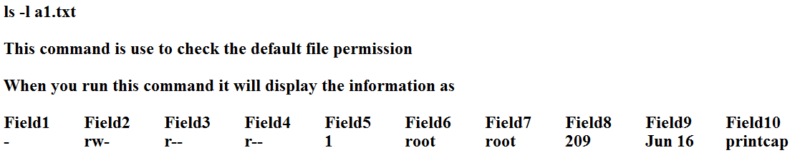
Default file Information

Slide 104
All fields information
The first field could be
- for file, d for directory , l for link
The second, third and fourth field
Second - The owner has over the file
Third -- the group has over the file
Fourth -- Everybody else has over the file
Fifth
This field specifies the number of links or directories inside this directory

Slide 105
Continue...
Sixth
The user that owns the file or directory
Seventh
The group that file belongs to, and any user in that group will have the permissions given in the third filed over that file.
Eight
The size in bytes, you may modify this by using the -h option together with -l will have the output in k,M,G for a better understanding.
Ninth
The date of last modification
The tenth field
The name of the file.

Slide 106
chmod
There are 3 types of permissions on a file/directory:
-read (R)
-write (w)
-execute (x)
• chmod command is used to change the permissions on a file for owner, group and others
chmod <permission><filename>

Slide 107
Chmod Cont…
Symbolic Method:
Code | Meaning
a | All
u | User
g | Group
o | Other
+ | Add
- | Remove
= | assign

Slide 108
Provide the permission
$chmod u+x demo – to provide execute permission to the user
$chmod u-x demo – to remove the execute permission from the user for the file demo
$chmod ugo +x demo – to provide execute file permission to all the three groups of users for the file named demo.

Slide 109
Chmod commands
chmod u+x a1.txt
This command is use to add the execute permission to the file.
chmod u-r a1.txt
This command is use to remove the read permission to the file.
chmod u-w a1.txt
This command is use to remove the write permission to the file
chmod u+w a1.txt
This command is use to add the permission to the file.
chmod u-wx,g-x,o-x a1.txt
This remove permission of Write, execute for user and execute for group and others

Slide 110
Chmod with numbers
chmod 754 a1.txt
Here the digits 7,5 and 4 each individually represents the permissions for the user, group and others.
Each digits is a combination of the numbers 4, 2, 1 and 0.
4 stands for "read"
2 stands for "write
1 stands for "execute and
0 stand for no permission
So 7 is the combination of permission 4+2+1(read, write and execute), 5 4+0+1 (read, no write and execute) and 4 is 4+0+0 (read, no write no execute).

Slide 111
Continue…
• Absolute value Method:
$ chmod 754 sampl
$chmod 777 fileabc – changes the file permissions of all the users to acquire all the 3 permissions
Code | Meaning
4 | Read
2 | Write
1 | Execute

Slide 112
Types of Access
60
There are three types of access for each file and directory:
Read
files: directories:
contents can be examined. contents can be examined.
Write
files: directories:
contents can be changed. contents can be changed.
Execute
files: directories:
file can be used as a command.
can become current working directory.

Slide 113
Module
79
Shell Scripting

Slide 114
What Is a Shell?
A shell is a program that takes commands typed by the user and calls the operating system to run those commands.
A shell is a program that acts as the interface between you and the Linux system, allowing you to enter commands for the operating system to execute.
Shell accepts your instruction or commands in English and translate it into computers native binary language

Slide 115
Why Use Shells?
You can use shell scripts to automate administrative tasks.
Encapsulate complex configuration details.
Get at the full power of the operating system.
The ability to combine commands allows you to create new commands
Adding value to your operating system.

Slide 116
Types of shell
There are two types of shell
The Bourne shell : The prompt for this shell is $.
POSIX shell also known as sh
Korn shell aslo kwew as ssh
Borune Again SHell also knew as bash
The C shell :The prompt for this shell is %
C shell also known as csh
Tops c shell also is known as tcsh

Slide 117
Find details about the shell
To find all available shells in your system type following command:
$ cat /etc/shells
The basic Syntax :
chsh
The administrator can change your default shell.
sudo apt install shellName/moduelName

Slide 118
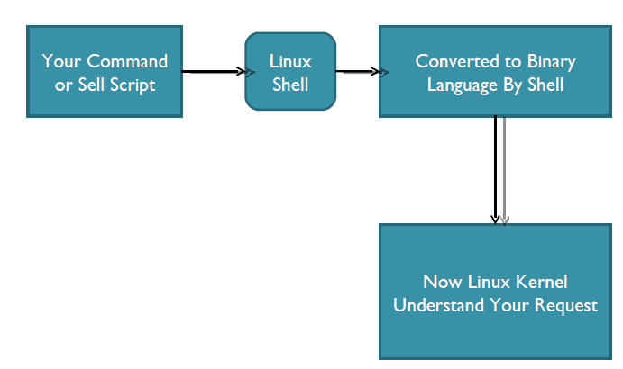
This is what Shell Does for US

Slide 119
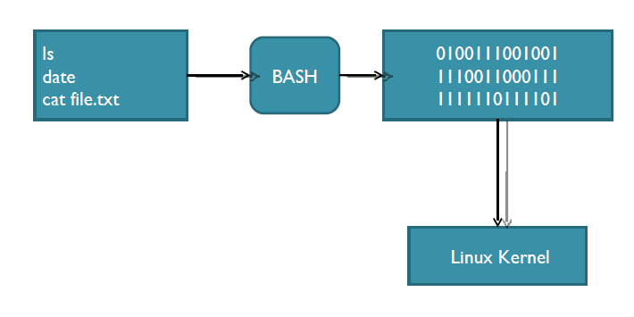
Example

Slide 120
The Shell as a Programming Language
Now that we’ve seen some basic shell operations, it’s time to move on to scripts.
There are two ways of writing shell programs.
You can type a sequence of commands and allow the shell to execute them interactively.
You can store those commands in a file that you can then invoke as a program(shell script).

Slide 121
Shell Scripting
Shell script is a series of command(s) stored in a plain text file.
A shell script is similar to a batch file in MSDOS, but is much more powerful.
Shell script can take input from user, file and output them on screen.
Useful to create our own commands.
Save lots of time.
To automate some task of day today life.
System Administration part can be also automated.

Slide 122
Practical examples where shell scripting actively used:
Monitoring your Linux system.
Data backup and creating snapshots.
Find out what processes are eating up your system resources.
Find out available and free memory.
Find out all logged in users and what they are doing.
Find out if all necessary network services are running or not.

Slide 123
Create a script
As discussed earlier shell scripts stored in plain text file, generally one command per line.
vi myscript.sh
Make sure you use .bash or .sh file extension for each script. This ensures easy identification of shell script.

Slide 124
Setup executable permission
Once script is created, you need to setup executable permission on a script. Why?
Without executable permission, running a script is almost impossible.
Besides executable permission, script must have a read permission.
Syntax to setup executable permission:
$ chmod u+x your-script-name.
$ chmod 755 your-script-name.

Slide 125
Run a script (execute a script)
Now your script is ready with proper executable permission on it. Next, test script by running it.
bash your-script-name
sh your-script-name
./your-script-name

Slide 126
What is shell scripting
Shell scripting is writing a series of command for the shell to execute. It can combine lengthy and repetitive sequences of commands into a single and simple script, which can be stored and executed anytime.
If the terminal end with bash ($) sign stands for a shell variable, echo will return the text whatever you typed in.
Shell scripting She-bang
The sign #! is called - bang and is written at top of the script. It passed instruction to program
/bin/sh

Slide 127
Sample Example
First bash shell program
#!/bin/bash
echo "Welcome bash shell"
First ksh shell program
#!/bin/ksh
echo "Welcome to ksh shell"
First C shell program
#!/bin/csh
echo "Welcome to C shell program "

Slide 128
Variables in Shell
Variables : Variables is name which hold the value.
In Linux (Shell), there are two types of variable:
System variables - Created and maintained by Linux itself. This type of variable defined in CAPITAL LETTERS.
User defined variables (UDV) – Created and maintained by user. This type of variable defined in lower letters.

Slide 129
Few pre-defined system variables
BASH
BASH_VERSION
COLUMNS
HOME
LOGNAME
PATH
PWD
SHELL
USER

Slide 130
User defined variables (UDV)
To define UDV use following syntax:
variable name=value
$ no=10
Rules for Naming variable name
Variable name must begin with Alphanumeric character or underscore character (_), followed by one or more Alphanumeric character.
Don't put spaces on either side of the equal sign when assigning value to variable.
Variables are case-sensitive.
You can define NULL variable
Do not use ?,* etc, to name your variable names.

Slide 131
Print or access value of UDV
To print or access UDV use following
syntax :
$variablename.
Examples:
$vech=Bus
$ n=10
$ echo $vech
$ echo $n

Slide 132
Continue…
Don’t try
$ echo vech
it will print vech instead its value 'Bus‘.
$ echo n
it will print n instead its value '10‘.
You must use $ followed by variable name.

Slide 133
Assignment
Define variable x with value 10 and print it on screen.
Define variable xn with value SUST and print it on screen.
print sum of two numbers, let's say 6 and 3 .
print your id, name, salary and desg.

Slide 134
Shell Arithmetic
Syntax:
expr op1 math-operator op2
Examples:
$ expr 1 + 3
$ expr 2 – 1
$ expr 10 / 2
$ expr 20 % 3
$ expr 10 \* 3
$ echo `expr 6 + 3`

Slide 135
The read Statement
Use to get input (data from user) from
keyboard and store (data) to variable.
Syntax:
read variable1
read id name salary

Slide 136
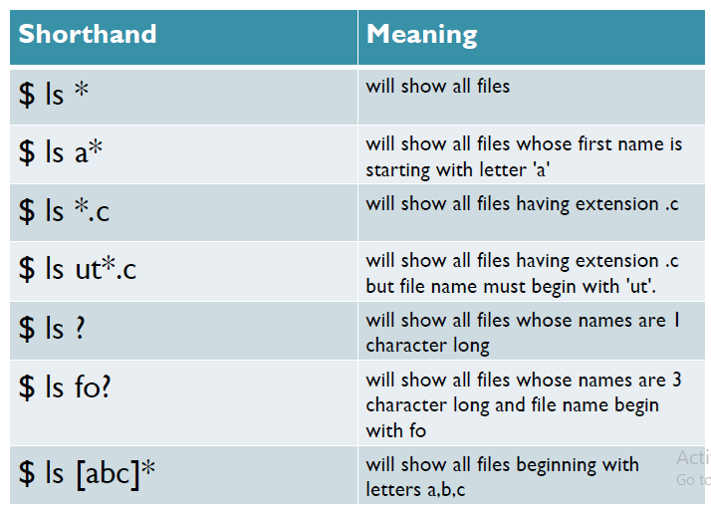
Shorthand

Slide 137
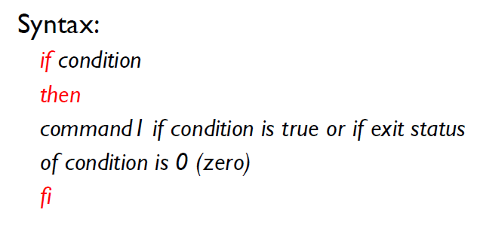
if condition

Slide 138
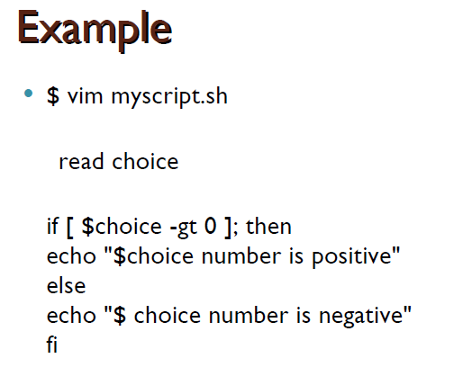

Slide 139
Simple if statement
if [ $((a)) -gt $((b)) ]; then
echo "a is largest"
else
echo "b is largest "
fi

Slide 140
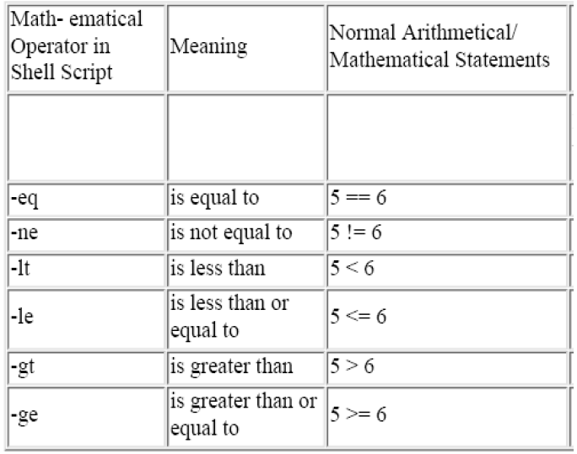

Slide 141
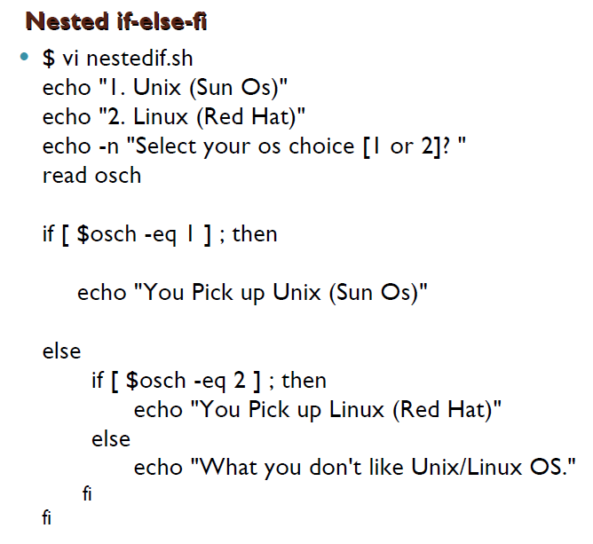

Slide 142
Command line arguments
$1 first argument
$2 second argument
$3 third argument
$0 name of the script
$* represents the all arguments
$# total number of arguments.

Slide 143
Loops in Shell Scripts
Three types of loops
While loop
Until loop
For loop

Slide 144
While loop
while [$i -lt $n];
do
echo $i
((i++))
done

Slide 145
Until loop
until [$i -gt $n];
do
echo $i
((i++))
done

Slide 146
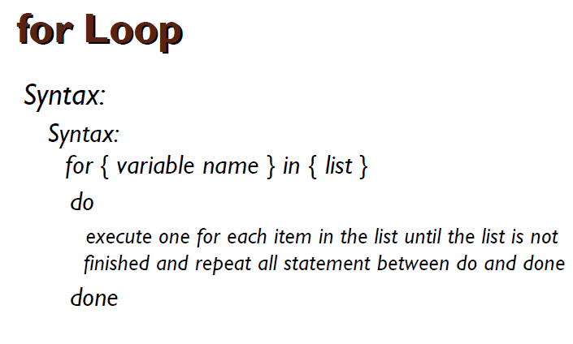

Slide 147
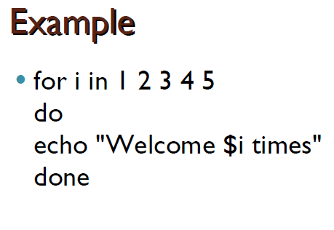

Slide 148
For loop
for((i=0;i<=10;i++))
do
echo $i
done

Slide 149
Functions
Function is series of instruction/commands.
Function performs particular activity in shell.
Syntax:
function-name ( )
{
Function body
}

Slide 150
Simple example of function
Function declaration
displayInfo() {
echo “Welcome to user defined function”
}
Calling function
displayInfo
displayInfo 100,200 : Function with passing parameter

Slide 151
The list in for loop
1. List from variables
158
for var in $PATH $HOME $MAIL
do
echo $var done
List from Wild cards
for file in *.c do
cc $file –o $file{x} done
List from positional parameters
for pattern in $* do
grep”$pattern” emp.lst || echo “pattern $pattern done
List from command substitution
not found”
for file in `cat wclwiswt`.scmGalaxy.com, Author - Rajesh Kumar

Slide 152
Labs
159
develop a script that accepts a file name as argument and displays the last modification time if the file exists and a suitable message if it doesn’t.
write a script that accepts one or more file names as arguments, and converts them all to upper case provided they exist.
Devise a script that lists files by modification time when called with lm and by access time when called with la. By default the script should show the listing of all files in the current directory
Write a script that uses find to look for a file and echo a suitable message if the file is not found. You must not store the output of the find to a file.
use the “if then” construct to write a script that will check for at least two parameters present on the command line. Output an appropriate
error message.
Write a shell script which will compare two numbers passed as command line arguments and tell which one is bigger.
Write a shell script which will add all the numbers between 0 and 9 and display the result.
Write a script which will give 4 choices to the user 1. ls 2. pwd 3. who 4. exit and execute the command as per the users choice

Slide 153
Labs contd.
160
Execute the date command with the proper arguments so that its output is in a mm-dd-yy format.
From your home directory, make the following directories with a single command line
d1, d1/d2, d1/d3, d1/d2/d4
create a file f1 in the home directory. Change the permissions to 777.
create a file f2 in your home directory and set setuid and sticky bit permissions on the file.
Write the command which will display all the files in the system having setuid set.
write the command to find all the files in your home directory hierarchy modified 1yr back and having a size more than 10 mb and delete the matching files interactively.
write two commands which will display all the ordinary files in the system

Slide 154
Labs contd.
161
Write a script that lists all the start scripts in a specified rc#.d directory
Name the script rcscripts
Write the script so that it doesn’t require command-line arguments
For all start scripts in /etc/rc3.d directory print
The script name
The inode number of the script
All other files under /etc with the same inode number
◻
◻
◻
Print all entries from /etc/passwd for users who have ksh as their login shell
Print the lines from /etc/group that contain the pattern root preceded by the line number
Print the number of users in the system.

